Slide 1
Health Friend
Health Monitoring App
Developed by Jamal Douglas, Jennifer Nichols, and Andrew Vargas

Slide 2
Project Goals
Health Friend App
-To create an app that is intended to aid and assist users with monitoring their health through updates and app notifications.
-Ultimately to satisfy consumer health needs through convenient and efficient health tracking app like no other.
-A unique Proprietary health information sharing application.

Slide 3
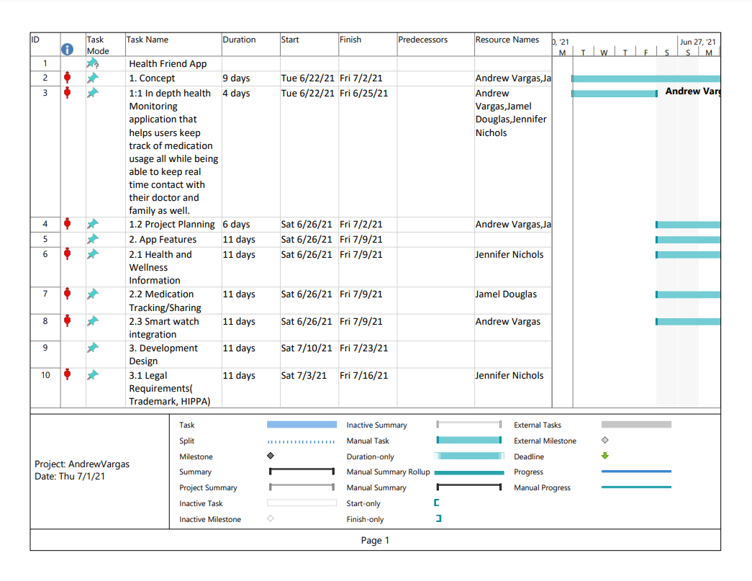
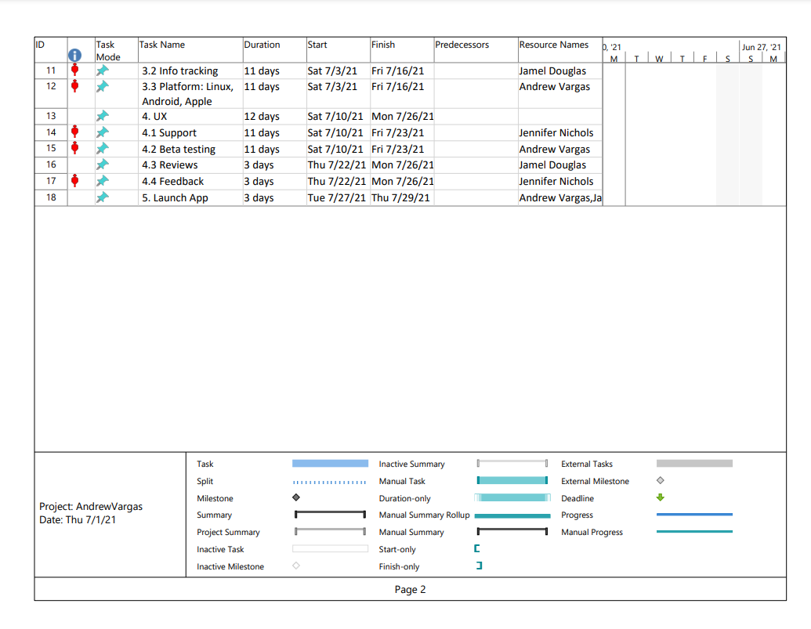
Activities

Slide 4
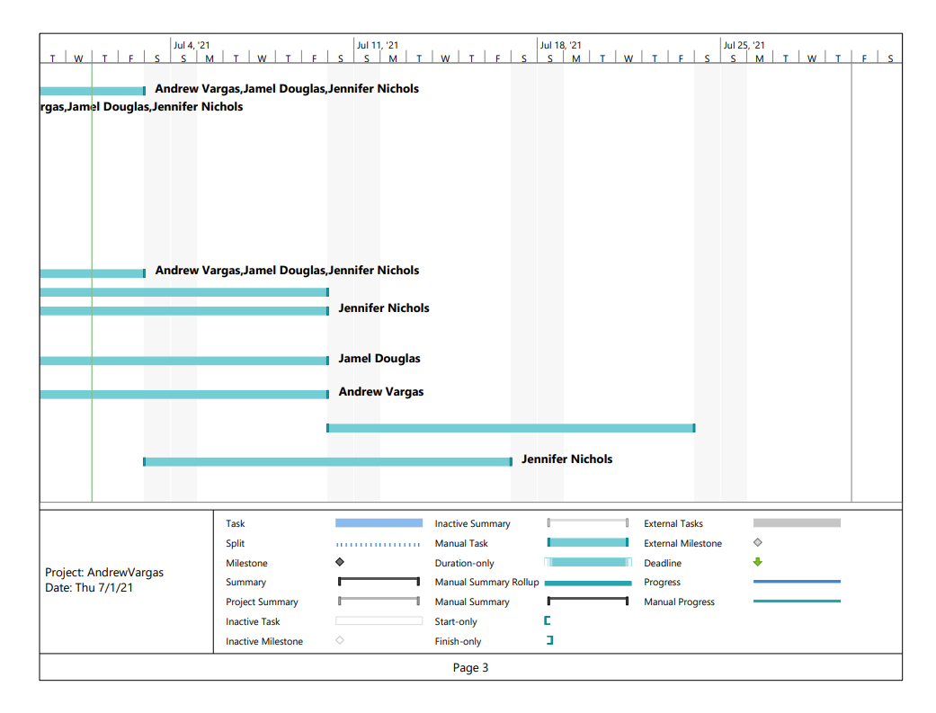
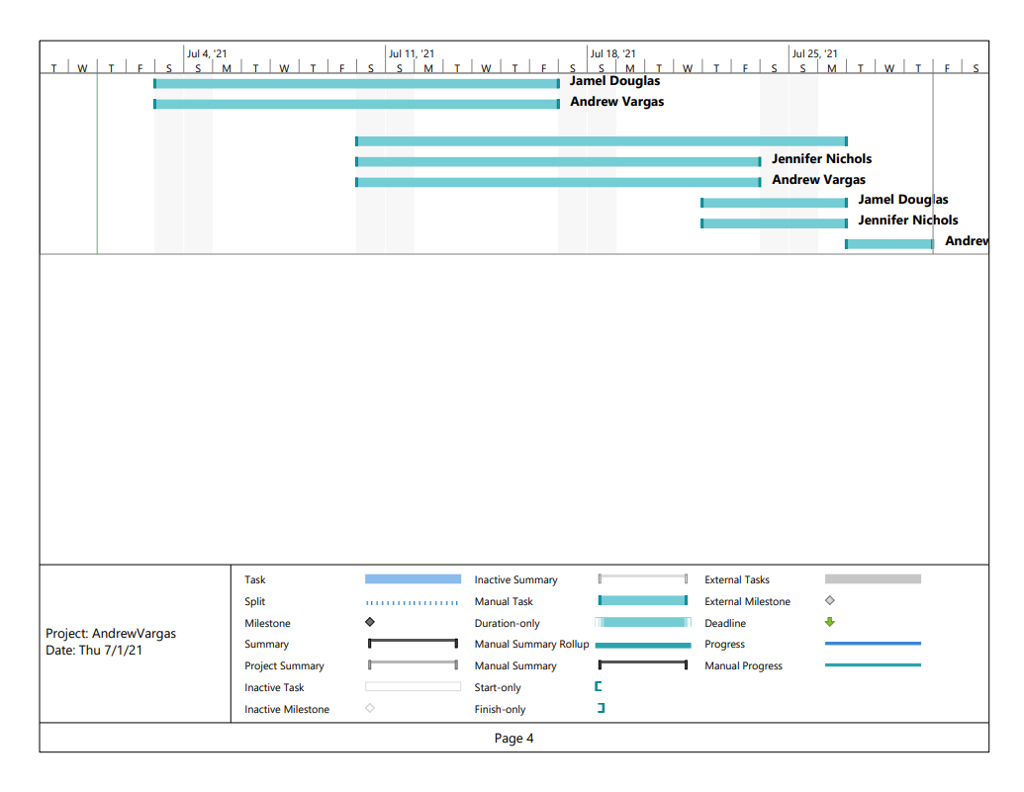
Gantt Chart

Slide 5
Work Breakdown Structure
Concept
-In depth health Monitoring smartphone app -helps users keep track of medication -Real time feedback -Project Planning
App Features
-Health and Wellness Information -Medication Tracking/Sharing -Smart watch integration
Development Design
-Legal Requirements (Trademark, HIPPA)
-Info tracking
-Platform: IoS, Android
UX
-Support
-Beta testing
-Reviews
-Feedback
Launch App

Slide 6
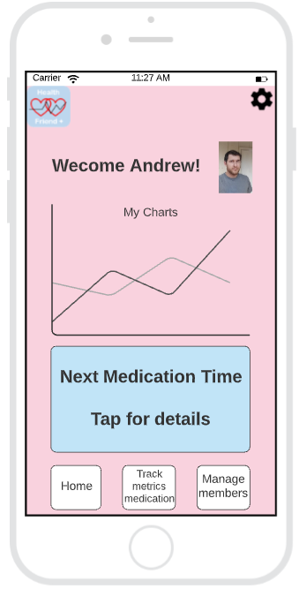
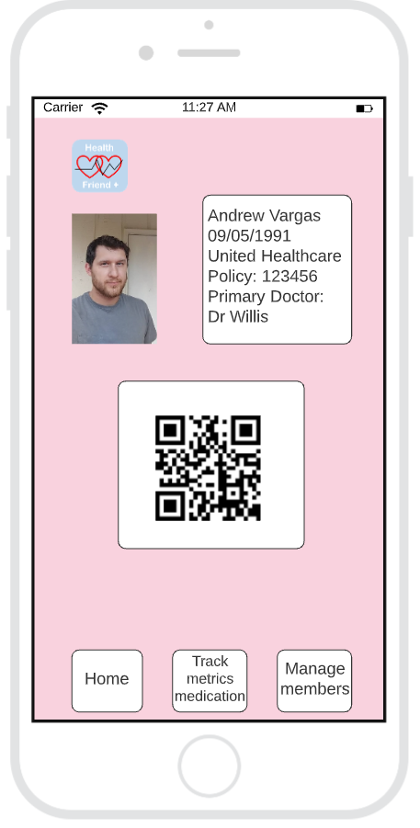
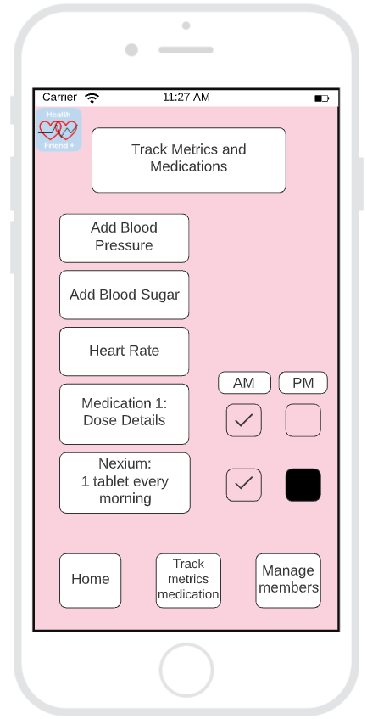
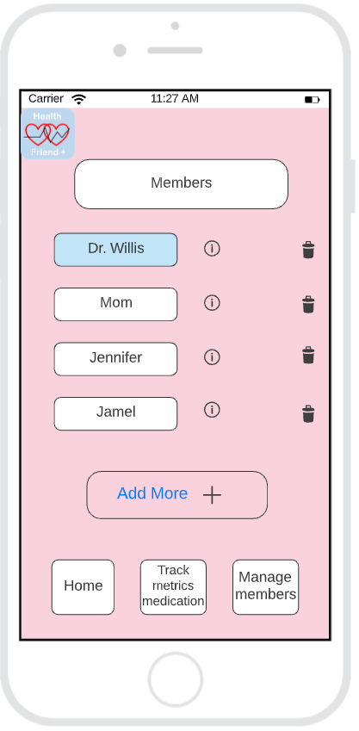
First Prototype

Slide 7
First Testing
-Most of the functionality of the app worked as intended
-Some buttons in the wireframe prototype were inactive such as the remove users button and “forgot email and password”
- More buttons had to be added to make app more realistic.
-No back buttons
-No save buttons
-Track metrics and medications page proved to be complicated

Slide 8
Final Prototype
https://lucid.app/lucidchart/c58b6782-3942-4ba8-87ea-70a964a41b4e/edit?page=maqT8pITtt5W#

Slide 9
Final Testing
-App redesign included the following:
-Removed Emergency call button. Not needed.
-Implemented save buttons throughout the application.
-Redesigned metrics and medication page.
- Added drop downs to charts.
-Added logout button.
-Removed extraneous pages to keep app refined and more streamlined.

Slide 10
Final Project Outcome
Please refer to our
Wix website for Health Friend App: https://jenichols74.wixsite.com/healthfriendapp

Slide 11
Accomplishments
-Learned how to create a cohesive and functioning wireframe prototype.
-Successfully uploaded our application to wix website for presentation.
-Learned how to use organizational tools such as Gantt chart and Work Breakdown Structure.
-Created an app that is both very realistic and achievable within a professional development environment.
-Used surveying of friends and family to be able to fine tune our app towards the specific needs of the consumer.

